Slide 1
THE RELATIONAL MODEL

Slide 2
INTRODUCTION
Relational Model is the major data model for commercial data processing applications. Data in the relational model is represented by a relation. A relation consists of a relational schema and relational instance.
The relational schema consist of relation’s name, name of each field and domain (range) of each field. For e.g., relational schema of students is shown below:-
STUDENT (Rollno: integer, Name: string, Marks: integer, Addr: string).
A relational instance is a set of tuples (records) in which each tuple has same number of fields as defined in the relational schema.

Slide 3
EXAMPLE
DOMAIN
- - - - -
- - - - -
- - - - -
- - - - -
- - - - -
- - - - -
- - - - -
- - - - -
Roll No | Name | Marks | Addr
101 | A | 80 | G
102 | B | 81 | H
103 | C | 82 | I
104 | D | 83 | J
105 | E | 84 | K
TUPLES
(Records)
RELATION
Fields (Attributes)
Degree (Arity)
[Arity = 04
Cardinality = 05]

Slide 4
The instance of student’s schema shown above consist of 5 tuples. Number of tuples in a given relation is called Cardinality of a given relation, i.e. cardinality of the above figure is 5.
The number of attributes in a given relation is called Degree of a relation, i.e. in the above diagram, degree is equal to 4. A degree of a relation is also called Arity.
Cardinality of a relation = No. of tuples in a given relation
Degree of a relation = No. of attributes in a given relation

Slide 5
Domain of an attribute is the range of values from which a value can be assigned to an attribute. Domain of a field is also the type of the fields like integer, date, etc. It specify which set of values can be stored in a given attribute of the database.
It also specify what type of operators can be applied on that. For e.g., if the attribute is of type integer then,
+,-,*,/ operators can be used to perform arithmetic.
<,>,<=,>= operators can be used to perform comparisons.
|| (Concatenation/Join) operator can’t be used for integer since they are meant for strings.
Domain Constraint:- The constraints that can be applied on a domain of an attribute called constraint. Constraints specified the schema must be used in the instance.

Slide 6
RELATIONAL ALGEBRA
Relational Algebra is a formal query language associated with relational model. Relational algebra queries consists of various operators.
An important property of relational algebra is that every operator in the relational algebra accepts the relational instances as input and returns a relational instance as output.

Slide 7
Basic operators available in relational algebra are following:-
SELECTION (σ).
PROJECTION (∏).
UNION (∪).
INTERSECTION (∩).
CROSS PRODUCT (Cartesian Product) (x).
DIFFERENCE (Set difference) (–).
RENAME (ρ).
DIVISION (/).
JOIN ( )
(Note:- 3-6 are None of the above(or Binary operations). 1,2,7 Unary operations because they operate on one relation )

Slide 8
SAMPLE TABLES
SID | SNAME | RATING | AGE
1 | S1 | 2 | 25
2 | S2 | 3 | 26
3 | S3 | 1 | 22
4 | S4 | 2 | 21
5 | S5 | 4 | 20
(A) Sailors Table
BID | BNAME | COLOUR
11 | B1 | RED
12 | B2 | BLUE
13 | B3 | GREEN
(B) Boats Table

Slide 9
SAMPLE TABLE
SID | BID | DATE
S1 | B11 | 10/09/2012
S1 | B12 | 10/09/2012
S1 | B13 | 10/09/2012
S2 | B11 | 11/09/2012
S3 | B11 | 11/09/2012
S3 | B12 | 11/09/2012
S4 | B13 | 12/09/2012
S4 | B11 | 12/09/2012
S4 | B12 | 12/09/2012
S4 | B13 | 14/09/2012
(C) Reserve Table

Slide 10
SELECT OPERATION
The select operation selects tuples that satisfy a given predicate (condition). We use the lower Greek letter sigma (σ) to denote selection. For e.g.
Let us assume ‘S’ in the instance(relation) of sailors.
Q. Find details of all sailors
Sol. σ (s).
Q. Find details of all sailors with rating greater than 1.
Sol. σ rating > 1 (s).

Slide 11
PROJECTION OPERATION
The projection operator is used to project columns. It is represented by Greek Letter pi (∏). The projection operator allows us to extract columns from a relation. For e.g.
Q. Find the names and rating of all the sailors.
Sol. ∏ SNAME, RATING(s).
Q. Find names and rating of all the sailors with rating greater than one.
Sol. ∏ SNAME, RATING(σ rating > 1 (s)).

Slide 12
SET OPARATIONS
Set operations are of four types:-
UNION (∪).
INTERSECTION (∩).
CROSS PRODUCT (Cartesian Product) (x).
DIFFERENCE (Set difference) (–).
Let us assume we have 3 instances named S1,S2 and R1.

Slide 13
SAMPLE TABLES
SID | SNAME | RATING | AGE
1 | S1 | 2 | 35
2 | S2 | 3 | 26
3 | S3 | 1 | 22
4 | S4 | 2 | 21
S1
SID | SNAME | RATING | AGE
3 | S3 | 1 | 22
4 | S4 | 2 | 21
5 | S5 | 4 | 20
S2
SID | BID | DATE
1 | 11 | 10/09/2015
1 | 12 | 20/11/2015
R1

Slide 14
UNION
Union of two instances S1 and S2 returns a relational instance, which contains all tuples that occur in either s1 or s2 or both. Two relational instances are called UNION compatible if they have same number of fields. For e.g. S = S1 ∪ S2
SID | SNAME | RATING | AGE
1 | S1 | 2 | 35
2 | S2 | 3 | 26
3 | S3 | 1 | 22
4 | S4 | 2 | 21
5 | S5 | 4 | 20

Slide 15
INTERSECTION
Intersection of two instances S1 and S2 returns a relational instance which contains all tuples that occur in both instances. For e.g.
S= S1 ∩ S2
SID | SNAME | RATING | AGE
3 | S3 | 1 | 22
4 | S4 | 2 | 21

Slide 16
DIFFERENCE
S1-S2 returns a relational instance which contains all tuples that occur in S1 and not in S2. The relational instance S1 and S2 must be union compatible. For e.g.
S=S1-S2 S=S2-S1
SID | SNAME | RATING | AGE
1 | S1 | 2 | 35
2 | S2 | 3 | 26
SID | SNAME | RATING | AGE
5 | S5 | 4 | 20

Slide 17
CROSS PRODUCT
Cross product of two relational instances S1 and R1 i.e. S1XR1 returns a relational instance which contains all fields of S1 followed by all fields of R1. The cross product of two relational instances is also called Cartesian Product. For e.g., S = S1XR1.
SID | SNAME | RATING | AGE | SID | BID | DATE
1 | S1 | 2 | 35 | 1 | 11 | 10/09/2015
1 | S1 | 2 | 35 | 1 | 12 | 20/11/2015
2 | S2 | 3 | 26 | 1 | 11 | 10/09/2015
2 | S2 | 3 | 26 | 1 | 12 | 20/11/2015
3 | S3 | 1 | 22 | 1 | 11 | 10/09/2015
3 | S3 | 1 | 22 | 1 | 12 | 20/11/2015
4 | S4 | 2 | 21 | 1 | 11 | 10/09/2015
4 | S4 | 2 | 21 | 1 | 12 | 20/11/2015

Slide 18
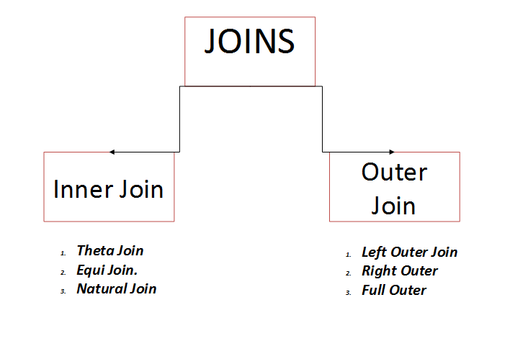
JOINS
The Join operator is one of the most useful operator in relational algebra and is used to combine information from two or more relations.

Slide 19
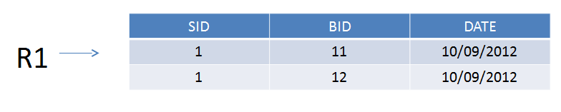
Sample Tables
SID | SNAME | RATING | AGE
1 | S1 | 2 | 25
2 | S2 | 3 | 26
3 | S3 | 1 | 22
4 | S4 | 2 | 21
5 | S5 | 4 | 20
S1

Slide 20
Inner join
An inner join is a join in which the values in the columns being joined are compared using a comparison operator
Three types:
Conditional or Theta Join
Equi Join
Natural Join

Slide 21
CONDITIONAL JOIN (Non-Equi Join)
In conditional joins, the given relations are combined with respect to some conditions.
For e.g. S1 S1.SID <= R1.SID R1
SID | SNAME | RATING | AGE | SID | BID | DATE
1 | S1 | 2 | 35 | 1 | 11 | 10/09/2012
1 | S1 | 2 | 35 | 1 | 12 | 10/09/2012

Slide 22
Equi Join
EQUI Join is a the special case of JOIN operators in which equality of columns is considered .
For e.g. S1 S1.SID = R1.SID R1
SID | SNAME | RATING | AGE | BID | DATE
1 | S1 | 2 | 35 | 11 | 10/09/2012
1 | S1 | 2 | 35 | 12 | 10/09/2012

Slide 23
Natural join
Natural join is a special case of join operators in which equalities are specified on all the fields with same name. The EQUI join expression is basically a NATURAL Join. Natural join can be represented as below:- S1 R1
SID | SNAME | RATING | AGE | BID | DATE
1 | S1 | 2 | 35 | 11 | 10/09/2012
1 | S1 | 2 | 35 | 12 | 10/09/2012

Slide 24
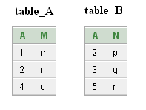
Left Outer Join Right Outer Join
Outer Join :- Use the SQL OUTER JOIN whenever multiple tables must be accessed and results should be returned if there is not a match between the Joined tables.

Slide 25
Left Outer Join Right Outer Join
A | M | A | N
1 | m | NULL | NULL
2 | n | 2 | p
4 | o | NULL | NULL
A | M | A | N
2 | n | 2 | p
NULL | NULL | 3 | q
NULL | NULL | 5 | r

Slide 26
Full Outer Join

Slide 27
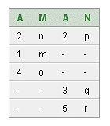
Full Outer Join

Slide 28
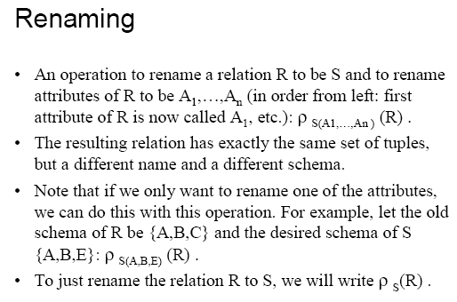
RENAME OPERATOR
Rename operator is used to avoid naming conflicts. Rename operator is represented by ρ.

Slide 29
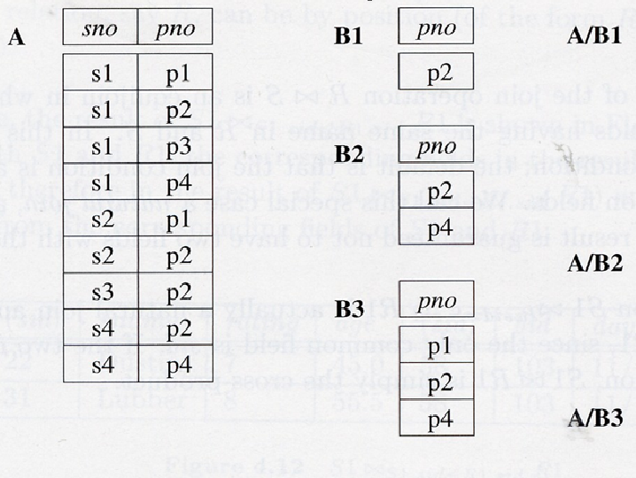
DIVISION OPERATOR
The division operator is useful for representing same special type of queries like:- Find the names of sailors who have reserved all boats.

Slide 30
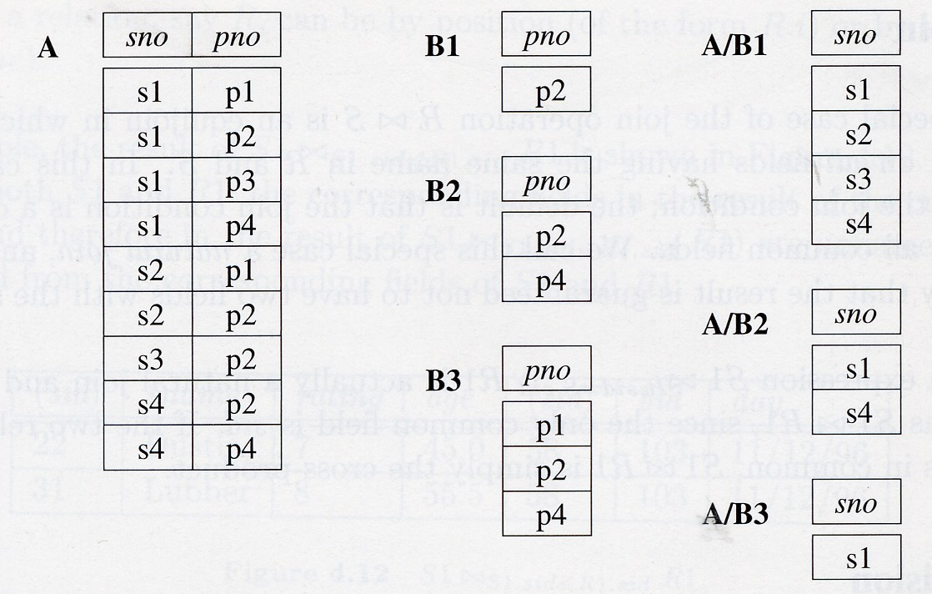
DIVISION OPERATOR
The division operator is useful for representing same special type of queries like:- Find the names of sailors who have reserved all boats.

Slide 31
RELATIONAL CALCULUS
Relational Calculus is a formal query language of relational model. Relational Calculus is an alternative to relational algebra, which is procedural, the calculus is non-procedural. Relational Calculus describes the answer without specifying how the answer is to be computed. Relational Calculus has important role in the design of commercial language like SQL.
Relational Calculus is of following types:-
Tuple Relational Calculus (TRC).
Domain Relational Calculus (DRC).

Slide 32
TUPLE RELATIONAL CALCULUS
A tuple variable is a variable that takes on tuples of a particular relational schema as values. Every value assigned to a tuple variable has some number and types of fields.
A tuple relational calculus query has a form:-
A nonprocedural query language, where each query is of the form
{t | P (t ) }
It is the set of all tuples t such that predicate P is true for t
t is a tuple variable, t [A ] denotes the value of tuple t on attribute A
t ∈ r denotes that tuple t is in relation r
P is a formula similar to that of the predicate calculus

Slide 33
Predicate Calculus Formula
1. Set of attributes and constants
2. Set of comparison operators: (e.g., <, ≤, =, ≠, >, ≥)
3. Set of connectives: and (∧), or (v)‚ not (¬)
4. Implication (⇒): x ⇒ y, if x if true, then y is true
x ⇒ y ≡ ¬x v y
5. Set of quantifiers:
∃ t ∈ r (Q (t )) ≡ ”there exists” a tuple in t in relation r such that predicate Q (t ) is true
∀t ∈ r (Q (t )) ≡ Q is true “for all” tuples t in relation r

Slide 34
Banking Example
branch (branch_name, branch_city, assets )
customer (customer_name, customer_street, customer_city )
account (account_number, branch_name, balance )
loan (loan_number, branch_name, amount )
depositor (customer_name, account_number )
borrower (customer_name, loan_number )

Slide 35
Example Queries
Find the loan_number, branch_name, and amount for loans of over $1200.
{t | t ∈ loan ∧ t [amount ] > 1200}
Find the loan number for each loan of an amount greater than $1200.
{t | ∃ s ∈ loan (t [loan_number] = s [loan_number] ∧ s [amount] > 1200)}

Slide 36
Example Queries
Find the names of all customers having a loan, an account, or both at the bank.
{t | ∃s ∈ borrower ( t [customer_name ] = s [customer_name ]) ∨ ∃u ∈ depositor ( t [customer_name ] = u [customer_name ])
Find the names of all customers who have a loan and an account at the bank.
{t | ∃s ∈ borrower ( t [customer_name ] = s [customer_name ]) ∧ ∃u ∈ depositor ( t [customer_name ] = u [customer_name] )

Slide 37
DOMAIN RELATIONAL CALCULUS
A nonprocedural query language equivalent in power to the tuple relational calculus
Each query is an expression of the form:
{ < x₁, x₂, …, x_{n} > | P (x₁, x₂, …, x_{n})}
x₁, x₂, …, x_{n} represent domain variables.
P represents a formula similar to that of the predicate calculus.

Slide 38
Example Queries
Find the loan_number, branch_name, and amount for loans of over $1200.
{< l, b, a > | < l, b, a > ∈ loan ∧ a > 1200}
Find the names of all customers who have a loan of over $1200.
{< c > | ∃ l, b, a (< c, l > ∈ borrower ∧ < l, b, a > ∈ loan ∧ a > 1200)}

Slide 39
Example Queries
Find the names of all customers who have a loan from the Perryridge branch.
{< c, a > | ∃ l (< c, l > ∈ borrower ∧
∃ b (< l, b, a > ∈ loan ∧ b = “Perryridge”))}

Slide 40
Pitfalls in Relational Database Design
Relational database design requires that we find a “good” collection of relation schemas. A bad design may lead to:-
Repetition of Information.
Inability to represent certain information.
Design Goals:
Avoid redundant data.
Ensure that relationships among attributes are represented.
Facilitate the checking of updates for violation of database integrity constraints.

Slide 41
Goal — Devise a Theory for the Following
Decide whether a particular relation R is in “good” form.
In the case that a relation R is not in “good” form, decompose it into a set of relations {R₁, R₂, ..., R_{n}} such that:-
each relation is in good form
the decomposition is a lossless-join decomposition

